Slide 1
WEB APPLICATION DEVELOPMENT FRAMEWORK : M23DE0204 MCA Sem II Academic Year : 2024 - 2025 Even Semester School of Computer Science and Applications Dr.N.Radha, Professor

Slide 2
Unit II
Web Application Development Framework

Slide 3
UNIT II
JavaScript
Introduction to JavaScript: what is the JavaScript and benefits of the language, JavaScript language syntax, Variable declaration, Operators, Control Statements, Error Handling, Understanding arrays, Function Declaration. Built in Functions, Standard Date and Time Functions in java script.

Slide 4
JAVASCRIPT
JavaScript is the scripting language of the Web.
JavaScript is used in millions of Web pages to add functionality, validate forms, detect browsers, and much more.
Introduction to JavaScript
JavaScript is used in millions of Web pages to improve the design, validate forms, detect browsers, create cookies, and much more.
JavaScript is the most popular scripting language on the Internet, and works in all major browsers, such as Internet Explorer, Mozilla Firefox,Chrome and Opera.

Slide 5
What is JavaScript?
JavaScript was designed to add interactivity to HTML pages
JavaScript is a scripting language
A scripting language is a lightweight programming language
JavaScript is usually embedded directly into HTML pages
JavaScript is an interpreted language (means that scripts execute without preliminary compilation)
Everyone can use JavaScript without purchasing a license
Java and JavaScript are two completely different languages in both concept and design!
Java (developed by Sun Microsystems) is a powerful and much more complex programming language – in the same category as C and C++

Slide 6
What can a JavaScript Do ?
JavaScript gives HTML designers a programming tool - HTML authors are normally not programmers, but JavaScript is a scripting language with a very simple syntax! Almost anyone can put small "snippets" of code into their HTML pages
JavaScript can put dynamic text into an HTML page - A JavaScript statement like this: document.write("<h1>" + name + "</h1>") can write a variable text into an HTML page
JavaScript can react to events - A JavaScript can be set to execute when something happens, like when a page has finished loading or when a user clicks on an HTML element
JavaScript can read and write HTML elements - A JavaScript can read and change the content of an HTML element
JavaScript can be used to validate data - A JavaScript can be used to validate form data before it is submitted to a server. This saves the server from extra processing
JavaScript can be used to detect the visitor's browser - A JavaScript can be used to detect the visitor's browser, and - depending on the browser - load another page specifically designed for that browser
JavaScript can be used to create cookies - A JavaScript can be used to store and retrieve information on the visitor's computer.

Slide 7
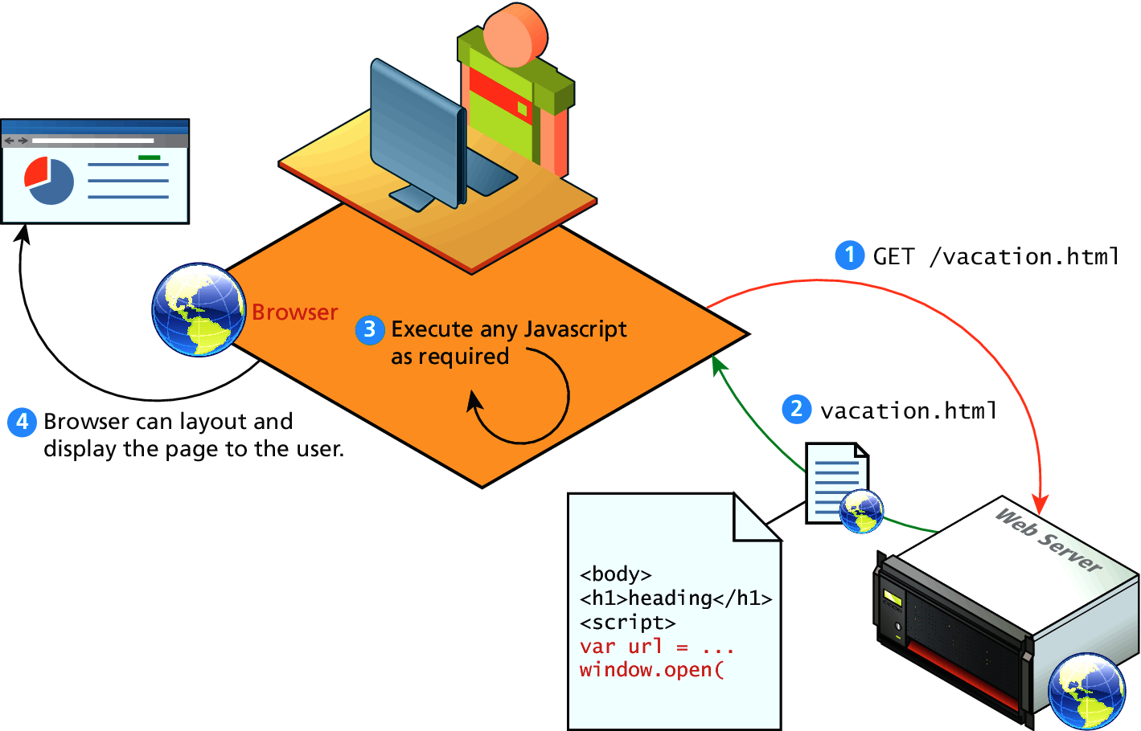
Client-Side Scripting
Let the client compute

Slide 8
Screen Output and keyboard input
The JavaScript model for the HTML document is the Document object
The model for the browser display window is the Window object
The Window object has two properties, document and window, which refer to the document and window objects, respectively
The Document object has a method, write, which dynamically creates content
The parameter is a string, often concatenated from parts, some of which are variables e.g., document.write("Answer: " + result + "<br />");

Slide 9
Screen Output and keyboard input
alert("Hai! \n");
Parameter is plain text, not HTML
Opens a dialog box which displays the parameter string and an OK button
confirm("Do you want to continue?");
Opens a dialog box and displays the parameter and two buttons, OK and Cancel
prompt("What is your name?", “ ");
Opens a dialog box and displays its string parameter, along with a text box and two buttons, OK and Cancel, the second parameter is for a default response if the user presses OK without typing a response in the text box

Slide 10
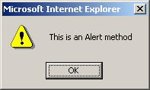
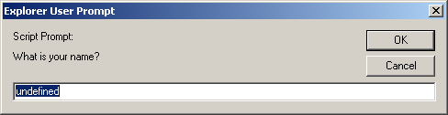
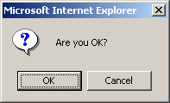
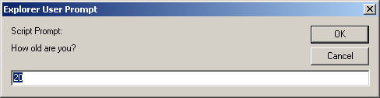
alert(), confirm(), and prompt()
<script type="text/javascript">
alert("This is an Alert method");
confirm("Are you OK?");
prompt("What is your name?");
prompt("How old are you?","20");
</script>

Slide 11
alert() and confirm()
Display a message in a dialog box.
The dialog box will block the browser.
alert("Text to be displayed");
var answer = confirm("Are you sure?");
Display a message in a dialog box with two buttons: "OK" or "Cancel".
confirm() returns true if the user click "OK". Otherwise it returns false.

Slide 12
prompt()
prompt("What is your student id number?");
prompt("What is your name?”, "No name");
Display a message and allow the user to enter a value
The second argument is the "default value" to be displayed in the input textfield.
Without the default value, "undefined" is shown in the input textfield.
If the user click the "OK" button, prompt() returns the value in the input textfield as a string.
If the user click the "Cancel" button, prompt() returns null.

Slide 13
Screen Output and keyboard input -example
<!DOCTYPE html>
<!-- roots.html A document for roots.js -->
<html lang = "en">
<head>
<title> roots.html </title>
<meta charset = "utf-8" />
</head>
<body>
<script type = "text/javascript" src = "roots.js" >
</script>
</body>
</html>

Slide 14
Screen Output and keyboard input -example
// roots.js
// Compute the real roots of a given quadratic equation. If the roots are imaginary, this script
// displays NaN, because that is what results from
// taking the square root of a negative number
// Get the coefficients of the equation from the user

Slide 15
Screen Output and keyboard input -example
var a = prompt("Find the solution for ax^2 + bx +c \n What is the value of 'a'? \n", "");
var b = prompt("What is the value of 'b'? \n", "");
var c = prompt("What is the value of 'c'? \n", "");
// Compute the square root and denominator of the result
var root_part = Math.sqrt(b * b - 4.0 * a * c );
var denom = 2.0 * a; // Compute and display the two roots
var root1 = (-b + root_part) / denom;
var root2 = (-b - root_part) / denom;
document.write("The first root is: ", root1, "<br />");
document.write("The second root is: ", root2, "<br />");

Slide 16
JavaScript Variables
Variables are "containers" for storing information.
JavaScript variables are used to hold values or expressions.
A variable can have a short name, like x, or a more descriptive name, like carname.
Rules for JavaScript variable names:
1. Variable names are case sensitive (y and Y are two different variables)
2. Variable names must begin with a letter or the underscore character Note: Because JavaScript is case-sensitive, variable names are case-sensitive.

Slide 17
Example
A variable's value can change during the execution of a script. You can refer to a variable by its name to display or change its value. <html> <body> <script type="text/javascript"> var firstname; firstname="Welcome"; document.write(firstname); document.write("<br />"); firstname="XYZ"; document.write(firstname); </script>
<p>The script above declares a variable, assigns a value to it, displays the value, change the value, and displays the value again.</p> </body> </html> Output : Welcome XYZ

Slide 18
Declaring (Creating) JavaScript Variables
Creating variables in JavaScript is most often referred to as "declaring" variables. You can declare JavaScript variables with the var statement:
var x; var carname;
After the declaration shown above, the variables are empty (they have no values yet). However, you can also assign values to the variables when you declare them: var x=5; var carname="Scorpio";
After the execution of the statements above, the variable x will hold the value 5, and carname will hold the value Scorpio.

Slide 19
Assigning Values to Undeclared JavaScript Variables
If you assign values to variables that have not yet been declared, the variables will automatically be declared. These statements: x=5; carname="Scorpio"; have the same effect as: var x=5; var carname="Scorpio";

Slide 20
Redeclaring JavaScript Variables
If you redeclare a JavaScript variable, it will not lose its original value
var x=5; var x; After the execution of the statements above, the variable x will still have the value of 5. The value of x is not reset (or cleared) when you redeclare it

Slide 21
DataTypes
Numbers - are values that can be processed and calculated. You don't enclose them in quotation marks. The numbers can be either positive or negative.
Strings - are a series of letters and numbers enclosed in quotation marks. JavaScript uses the string literally; it doesn't process it. You'll use strings for text you want displayed or values you want passed along.
Boolean (true/false) - lets you evaluate whether a condition meets or does not meet specified criteria.
Null - is an empty value. null is not the same as 0 -- 0 is a real, calculable number, whereas null is the absence of any value.

Slide 22
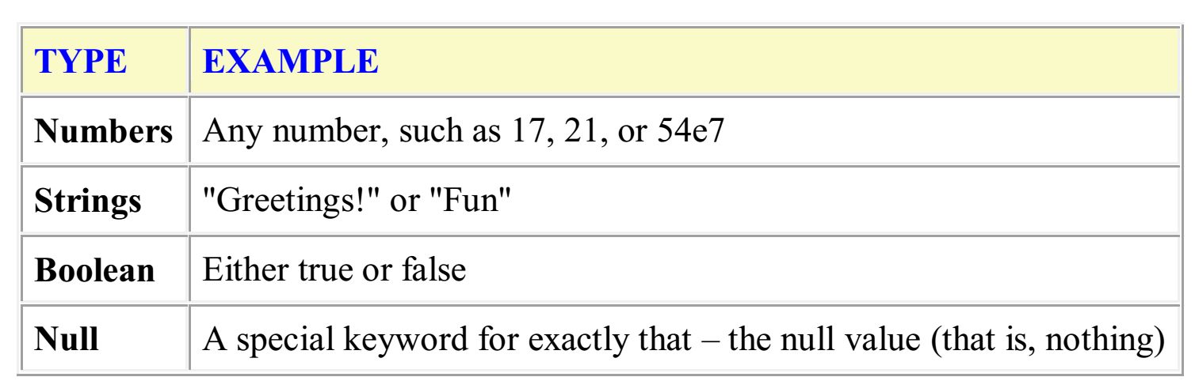
Data Types

Slide 23
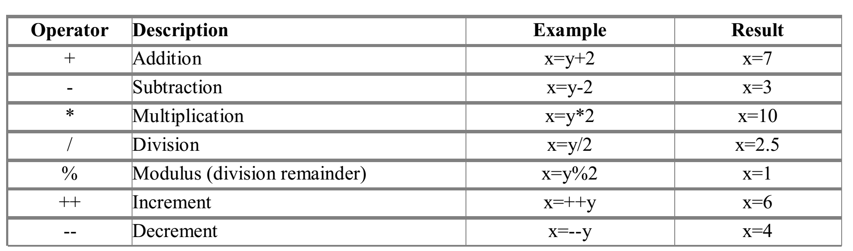
JavaScript OPERATORS
As with algebra, you can do arithmetic operations with JavaScript variables: y=x-5; z=y+5 JavaScript Arithmetic Operators

Slide 24
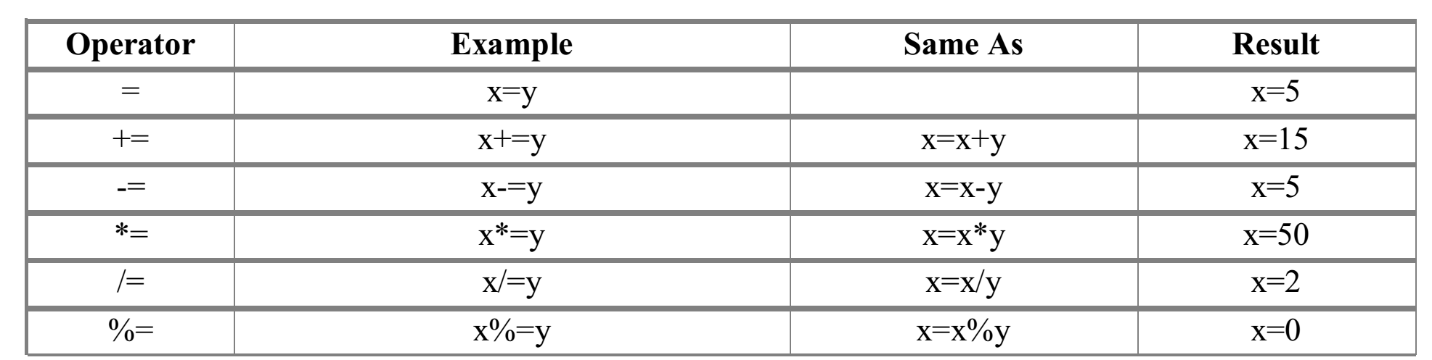
JavaScript OPERATORS
The + Operator Used on Strings The + operator can also be used to add string variables or text values together. To add two or more string variables together, use the + operator. Example:
txt1="What a very"; txt2="nice day"; txt3=txt1+txt2; x=5+5; document.write(x); x="5"+"5"; document.write(x); x=5+"5"; document.write(x); x="5"+5; document.write(x); If you add a number and a string, the result will be a string.
Assignment Operators

Slide 25
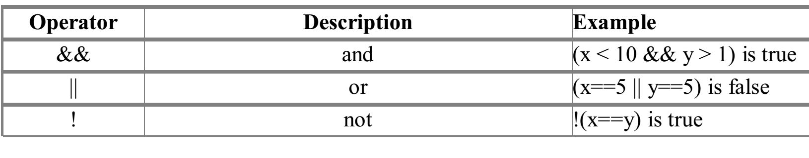
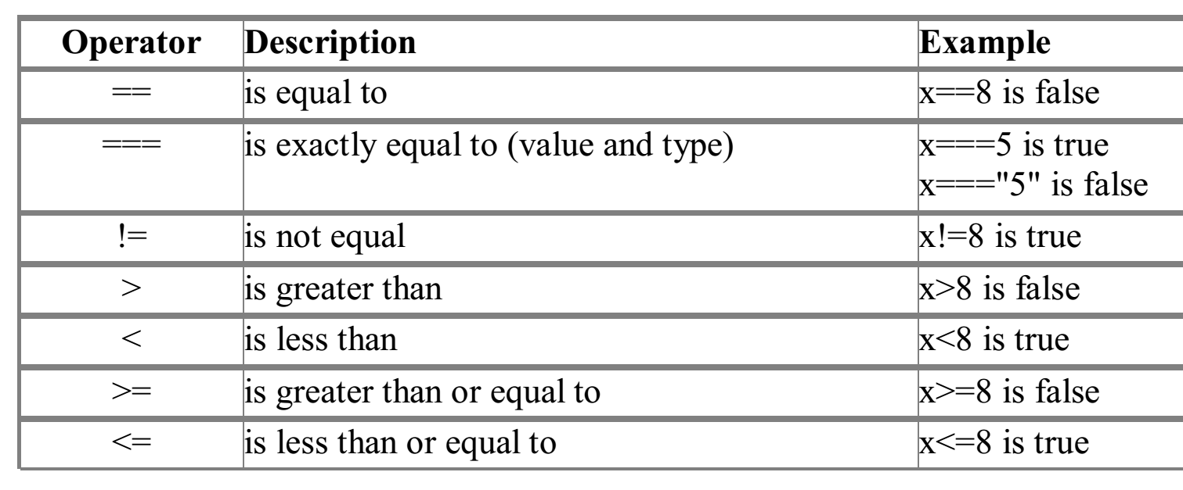
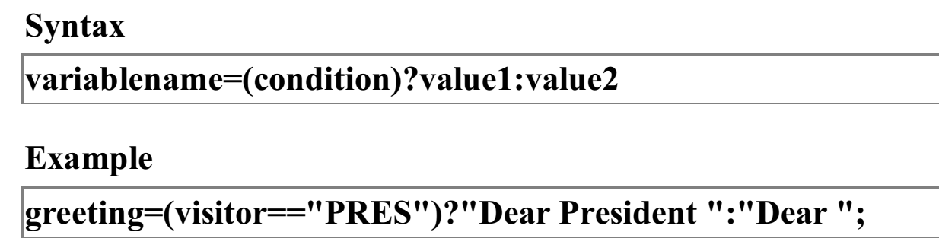
JavaScript OPERATORS
Logical Operators
Comparison Operators
Conditional Operator

Slide 26
Conditional Statements
In JavaScript we have the following conditional statements:
if statement - use this statement if you want to execute some code only if a specified condition is true
if...else statement - use this statement if you want to execute some code if the condition is true and another code if the condition is false
if...else if....else statement - use this statement if you want to select one of many blocks of code to be executed
switch statement - use this statement if you want to select one of many blocks of code to be executed

Slide 27
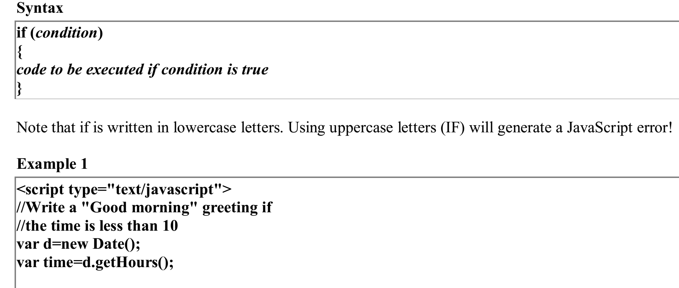
If Statement
You should use the if statement if you want to execute some code only if a specified condition is true

Slide 28
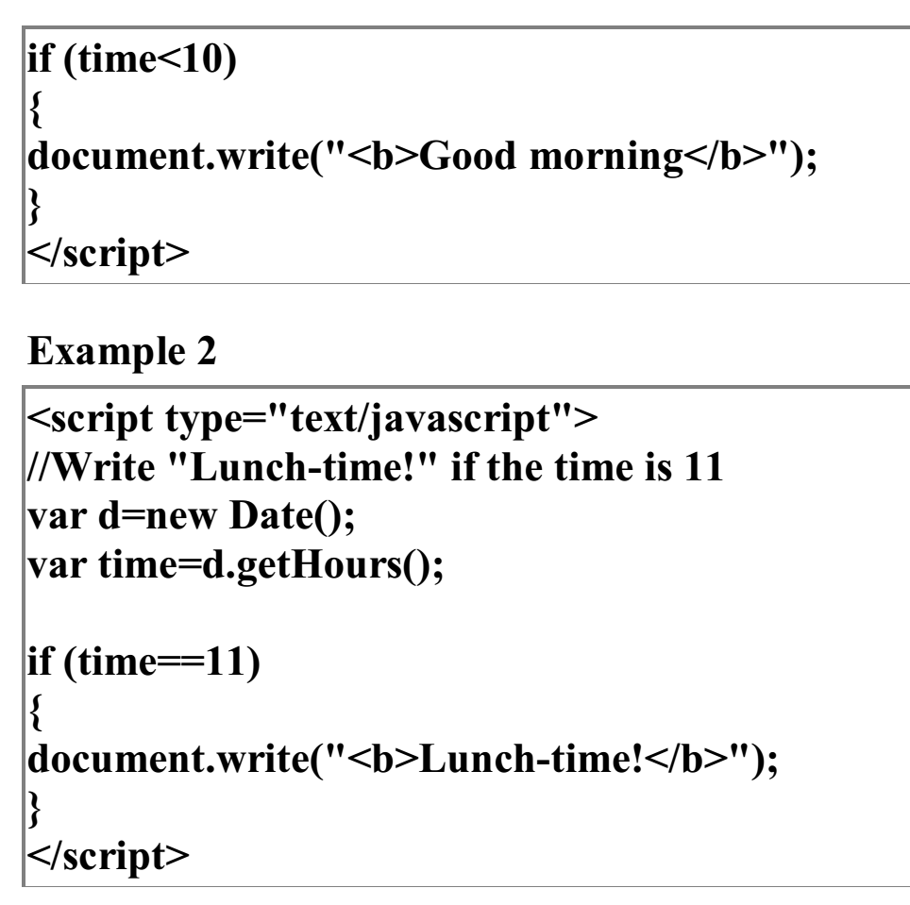

Slide 29
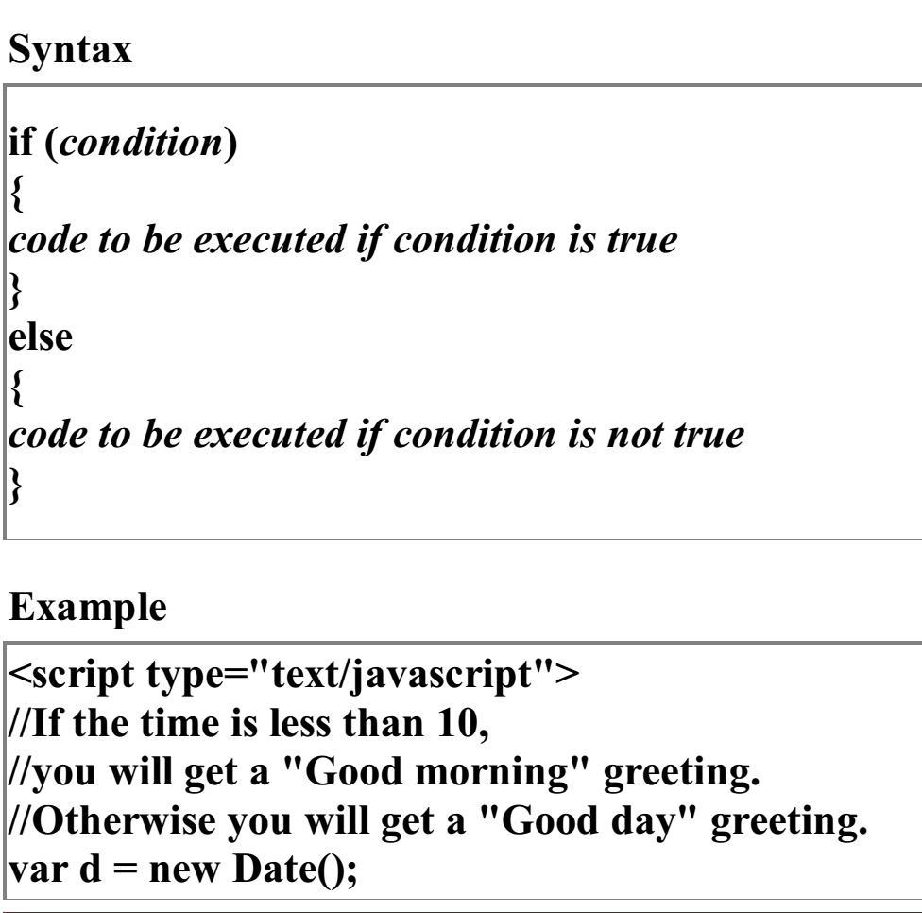
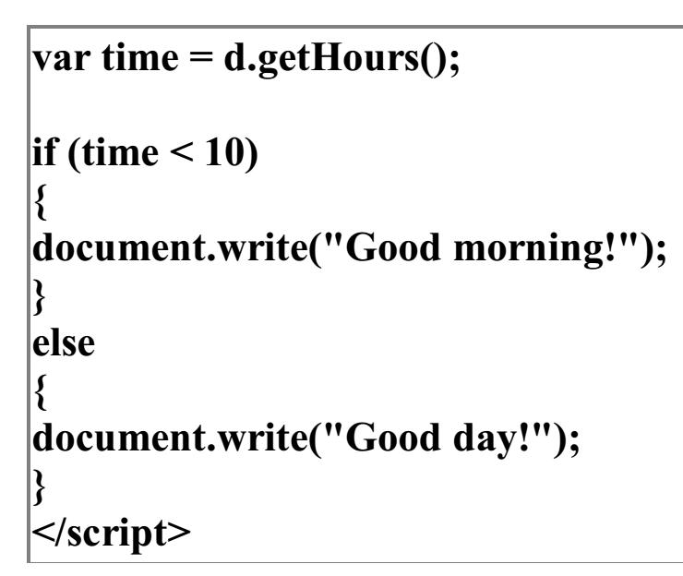
If...else Statement

Slide 30
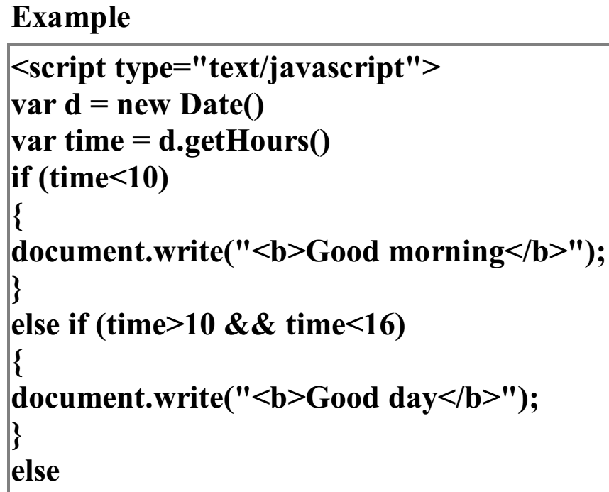
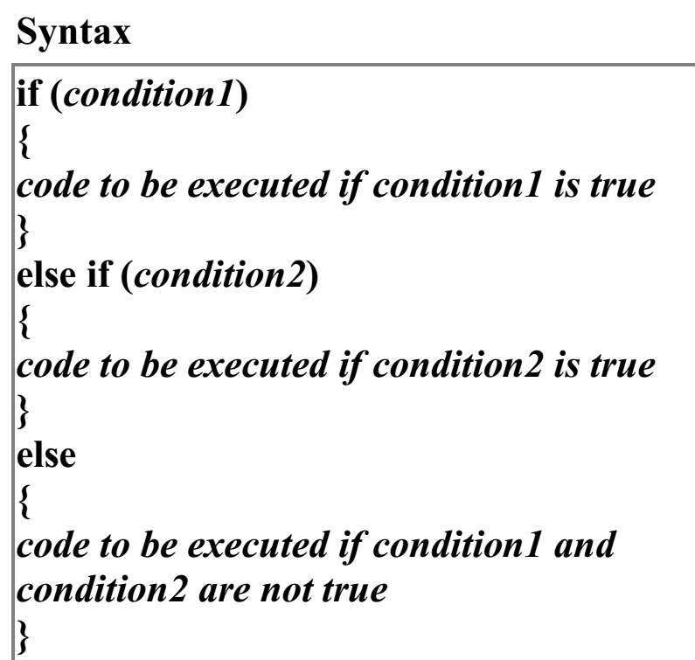
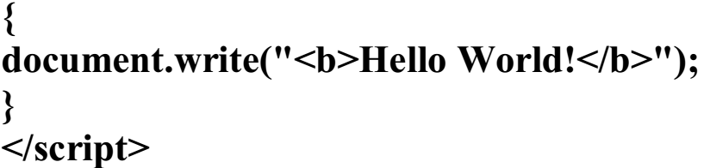
If...else if...else Statement

Slide 31
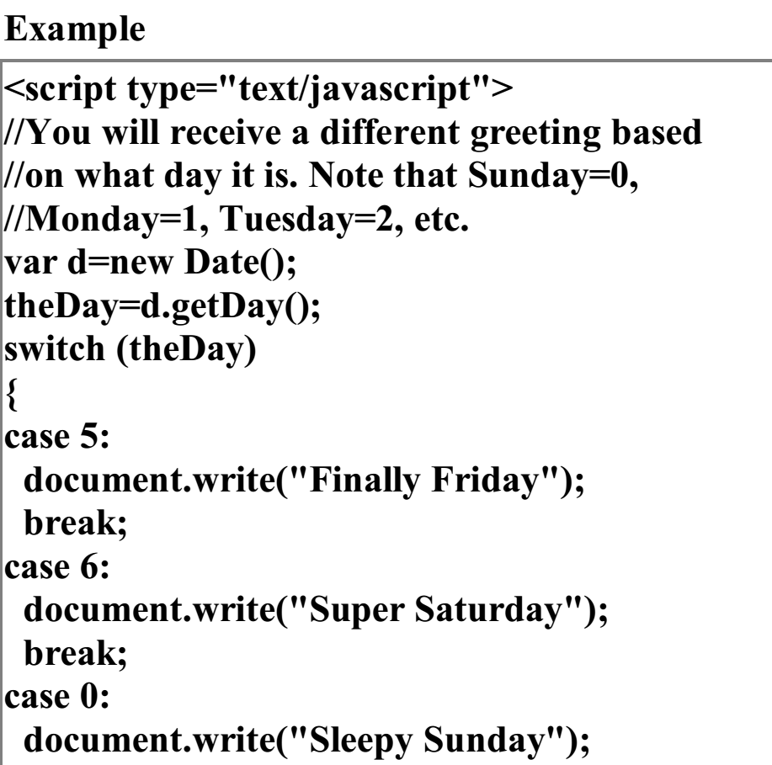
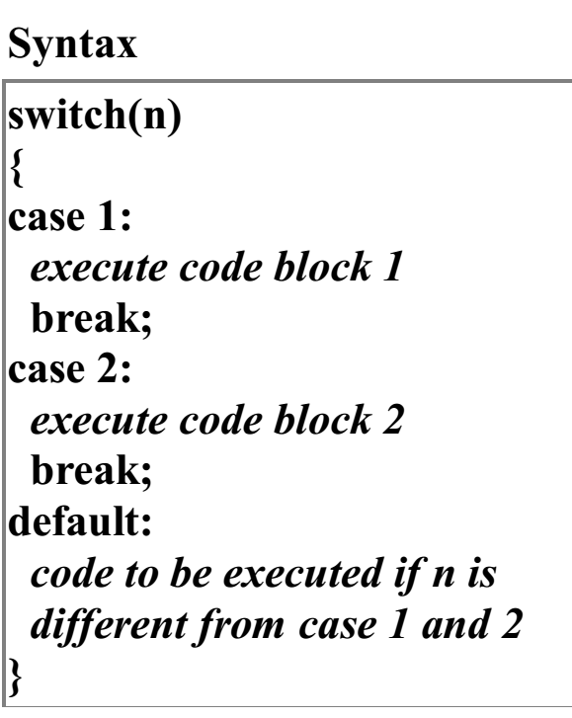
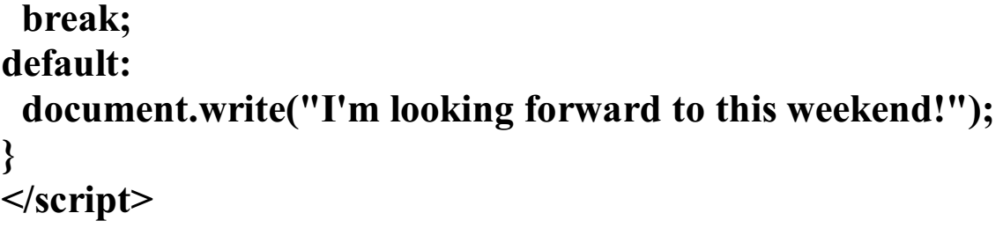
Switch Statement

Slide 32
Example 2
<Script>
Switch(document.frmAnimal.textAnimal.value){
Case “rabbit”:
Alert{“watch out, its Elmer Fudd!”) break;
Case “coyote”:
Alert{“No match for the road runner – meep meep!”) break;
Case “mouse”:
Alert{“watch out Jerry, here comes Tom!”) break;
default : alert(“Are you sure you picked an animal from a cartoon?”);}
</script></body></html>
<Html><body>
<p> Enter the name of your favorite type of animal that stars in a cartoon:</p>
<form name = “frmAnimal”>
<input type=“text” name =“txtAnimal”/><br/>
<input type =“button” value=“Check animal” onclick=“checkAnimal()”/> </form>

Slide 33
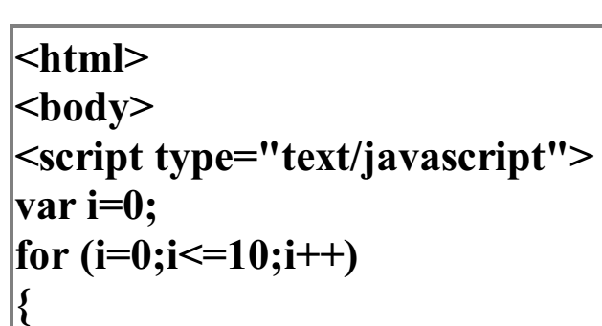
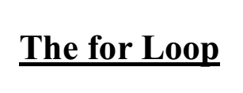
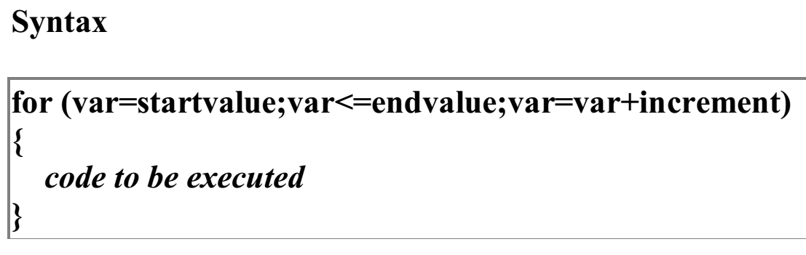
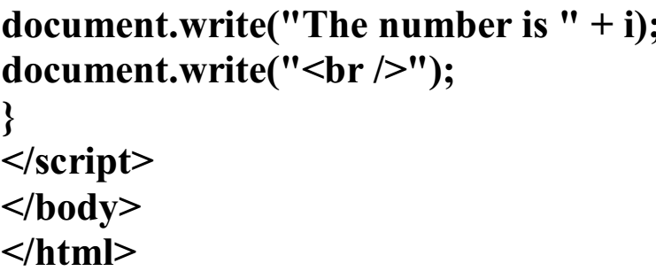
Controlling(Looping) Statements
In JavaScript there are three different kind of loops: 1. for - loops through a block of code a specified number of times 2. while - loops through a block of code while a specified condition is true
3. Do … While - This loop will always execute a block of code ONCE, and then it will repeat the loop as long as the specified condition is true

Slide 34
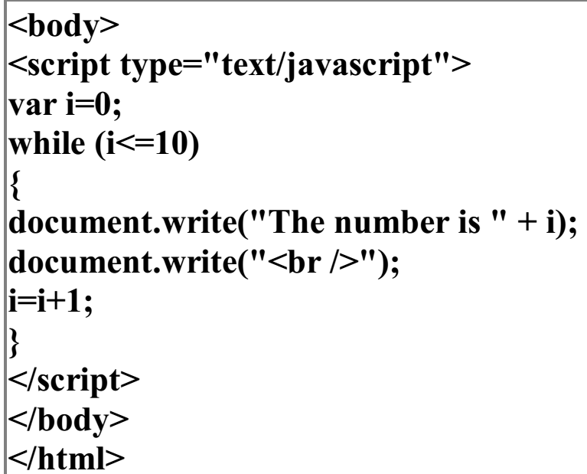
While Loop
Example
Syntax:
while (var<=endvalue) { code to be executed }

Slide 35
The do...while Loop
Example
<html> <body> <script type="text/javascript"> var i=0; do { document.write("The number is " + i); document.write("<br />"); i=i+1; } while (i<0); </script> </body> </html>
Result
The number is 0
Syntax:
do { code to be executed } while (var<=endvalue);

Slide 36
Break and Continue
Break The break command will break the loop and continue executing the code that follows after the loop (if any).
Example
Continue
<html> <body> <script type="text/javascript"> var i=0 for (i=0;i<=10;i++) { if (i==3){ continue; } document.write("The number is " + i); document.write("<br />"); } </script> </body> </html>
<html> <body> <script type="text/javascript"> var i=0; for (i=0;i<=10;i++) { if (i==3) { break; } document.write("The number is " + i); document.write("<br />"); } </script> </body></html>

Slide 37
JavaScript - Errors & Exceptions Handling
Error handling in JavaScript is a process to detect and handle errors that occurs during the execution of a program. Errors can be a syntax, runtime or logical errors. An error occurred during the execution of the program is called a runtime error or an exception
What is an Error?
An error is an event that occurs during the execution of a program that prevents it from continuing normally. Errors can be caused by a variety of factors, such as syntax errors, runtime errors, and logical errors.
Syntax Errors
Syntax errors, also called parsing errors, occur at compile time in traditional programming languages and at interpret time in JavaScript.

Slide 38
EXAMPLE
<script> window.print(); </script>
When a syntax error occurs in JavaScript, only the code contained within the same thread as the syntax error is affected, and the rest of the code in other threads gets executed, assuming nothing in them depends on the code containing the error.
Runtime Errors (Exceptions)
Runtime errors, also called exceptions, occur during execution (after compilation/interpretation).
For example, the following line causes a runtime error because the syntax is correct here, but at runtime, it is trying to call a method that does not exist.
<script> window.printme(); </script>

Slide 39
JavaScript runtime errors
ReferenceError − Trying to access an undefined variable/ method.
TypeError − Attempting an operation on incompatible data types.
RangeError − A value exceeds the allowed range.
Logical Errors
Logic errors can be the most difficult type of errors to track down. These errors are not the result of a syntax or runtime error. Instead, they occur when you make a mistake in the logic that drives your script and do not get the expected result.
For example, when you divide any numeric value with 10, it returns undefined.
<script> let num = 10/0; </script>

Slide 40
What is Error Handling?
Whenever any error occurs in the JavaScript code, the JavaScript engine stops the execution of the whole code. If you handle such errors in the proper way, you can skip the code with errors and continue to execute the other JavaScript code.
You can use the following mechanisms to handle the error.
The try statement lets you test a block of code to check for errors.
The catch statement lets you handle the error if any are present.
The throw statement lets you make your own errors.
The finally block runs regardless of the result of the try-catch block.

Slide 41
The try...catch...finally Statement
The latest versions of JavaScript added exception handling capabilities. JavaScript implements the try...catch...finally construct as well as the throw operator to handle exceptions.
You can catch programmer-generated and runtime exceptions, but you cannot catch JavaScript syntax errors.
Here is the try...catch...finally block syntax −
<script>
try { // Code to run [break;] }
catch ( e ) { // Code to run if an exception occurs [break;] }
[ finally { // Code that is always executed regardless of // an exception occurring }] </script>

Slide 42
try...catch...finally block syntax
Example
html>
<head>Exception Handling</head>
<body> <script>
try{
var a=2;
if(a==2)
document.write("ok");
}
catch(e){
document.write("Error found"+e.message);
}
finally{
document.write("Value of a is 2 ");
}
</script>
</body>
</html>
Output
Exception Handling okValue of a is 2
The try block must be followed by either exactly one catch block or one finally block (or one of both).
When an exception occurs in the try block, the exception is placed in e and the catch block is executed.
The optional finally block executes unconditionally after try/catch.

Slide 43
The throw Statement
You can use throw statement to raise your built-in exceptions or your customized exceptions. Later these exceptions can be captured and you can take an appropriate action.
Example
<html> <head>
<script>
function myFunc()
{ var a = 100; var b = 0;
try { if ( b == 0 ) {
throw( "Divide by zero error." ); }
else { var c = a / b; } }
catch ( e ) {
alert("Error: " + e );
} }
</script>
</head>
<body>
<p>Click the following to see
the result:</p>
<form>
<input type = "button" value = "Click Me“
onclick = "myFunc();" />
</form> </body>
</html>

Slide 44
Example - Error handling
<!DOCTYPE html> <html> <body> <p>Please input a number between 5 and 10:</p> <input id="demo" type="text"> <button type="button" onclick="myFunction()">Test Input</button> <p id="p01"></p> <script> function myFunction() { const message = document.getElementById("p01"); message.innerHTML = ""; let x = document.getElementById("demo").value; try { if(x.trim() == "") throw "empty"; if(isNaN(x)) throw "not a number"; x = Number(x); if(x < 5) throw "too low"; if(x > 10) throw "too high"; } catch(err) { message.innerHTML = "Input is " + err; }} </script> </body> </html>

Slide 45
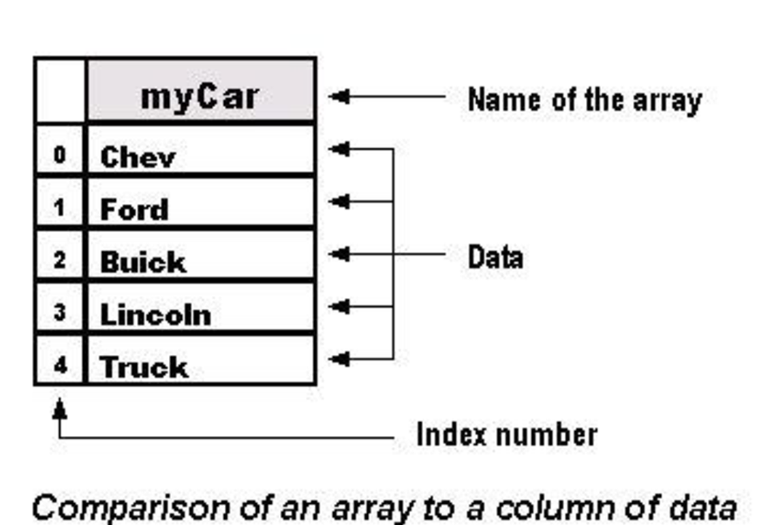
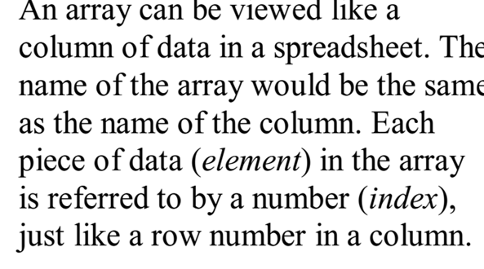
Arrays -
An array object is used to create a database-like structure within a script

Slide 46
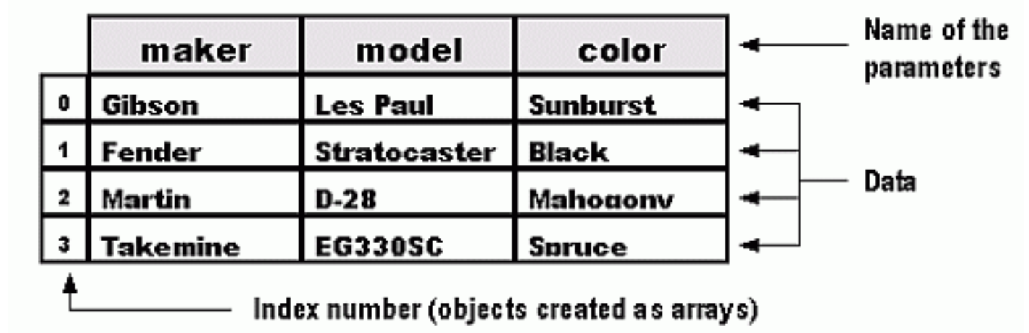
arrays
1. var myCar = new Array("Chev","Ford","Buick", "Lincoln","Truck"); alert(myCar[4]) The data point with an index of "4" would be Truck. In this example, the indexes are numbered as follows: 0=Chev, 1=Ford, 2=Buick, 3=Lincoln, and 4=Truck
2. var myCar = new Array(20);
Multidimensional Arrays

Slide 47
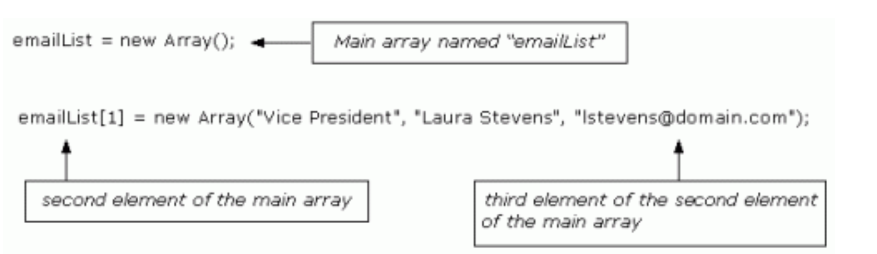
ARRAYS
Multidimensional arrays can be created in different ways. var emailList = new Array();
emailList[0] = new Array("President", "Paul Smith", "psmith@domain.com"); emailList[1] = new Array("Vice President", "Laura Stevens", "lstevens@domain.com"); emailList[2] = new Array("General Manager", "Mary Larsen", "mlarsen@domain.com"); emailList[3] = new Array("Sales Manager", "Bob Lark", "blark@domain.com");

Slide 48
ARRAYS
It would be written like this: var vpEmail = emailList[1][2] alert("The address is: "+ vpEmail)
1. We declared a variable, named it emailList, and initialized it with a value of a new instance of an array. 2. Next, we created an array for each of the elements within the original array. Each of the new arrays contained three elements. 3. Then we declared a variable named vpEmail and initialized it with the value of the third element (lstevens@domain.com) of the second element "[1]" of the array named emailList
You could also retrieve the information using something like: var title = emailList[1][0] var email = emailList[1][2] alert("The e-mail address for the " + title +" is: " + email)

Slide 49
Arrays - example
Array OBJECT CREATION
To create any object is with the new operator and a call to a constructor.
The second way to create an Array object is with a literal array value, which is a list of values enclosed in brackets
var my_list_2 = [1, 2, “three”, “four”];

Slide 50
arrays
CHARACTERISTICS OF Array OBJECTS
The lowest index of every JavaScript array is zero.
Access to the elements of an array is specified with numeric subscript expressions placed in brackets.
The length of an array is the highest subscript to which a value has been assigned, plus 1.

Slide 51
arrays
CHARACTERISTICS OF Array OBJECTS
The length of an array is both read and write accessible through the length property, which is created for every array object by the Array constructor.
my_list.length = 1002;
An array is lengthened by setting its length property to a larger value, shortened by setting its length property to a smaller value.

Slide 52
Array Methods
length The length property returns the number of elements in an array. The format is arrayName.length. example var bannerImg = new Array(); bannerImg[0]="image-1.gif"; bannerImg[1]="image-2.gif"; bannerImg[2]="image-3.gif"; var newBanner = 0 var totalBan = bannerImg.length function cycleBan() { newBanner++ if (newBanner == totalBan) { newBanner = 0 } document.banner.src=bannerImg[newBanner] setTimeout("cycleBan()", 3*1000) } window.onload=cycleBan;
This portion is then placed in the body where the banner is to be displayed: <img src="image-1.gif" name="banner">

Slide 53
arrays
Array Methods
The join method converts all of the elements of an array to strings and cancatenates them into a single string.
If no parameter is provided to join, the values in the new string are separated by commas.
If a string parameter is provided, it is used as the element separator.

Slide 54
Arrays - Methods
let numbers_array = [1, 2, 3, 4, 5];
console.log("Original Array: ");
console.log(numbers_array);
numbers_array.reverse();
console.log("Reversed Array: ");
console.log(numbers_array);
Original Array:
[ 1, 2, 3, 4, 5 ]
Reversed Array:
[ 5, 4, 3, 2, 1 ]
The reverse method reverses the order of the elements of the Array object through which it is called.
The sort method coerces the elements of the array to become strings if they are not already strings and sorts them alphabetically
The concat method cancatenates its actual parameters to the end of the Array object on which it is called.
// Create an Array const fruits = ["Banana", "Orange", "Apple", "Mango"]; // Sort the Array fruits.sort();
Apple,Banana,Mango,Orange
// Code to concat() method
function func() {
let num1 = [11, 12, 13],
num2 = [14, 15, 16],
num3 = [17, 18, 19];
console.log(num1.concat(num2, num3));}
func();
[
11, 12, 13, 14, 15, 16, 17, 18, 19
]

Slide 55
arrays
Array Methods
The slice method does for arrays what the substring method does for strings, returning the part of the Array object specified by its parameters, which are used as subscripts.
The value of list2 is [4,6]
When the toString method is called through an Array object, each of the elements of the object is converted (if necessary) to a string. These strings are cancatenated, separated by commas. So, for Array objects, the toString method behaves much like join.

Slide 56
example
<!DOCTYPE html>
<html> <body>
<h2>JavaScript Arrays</h2>
<p>The Array.toString() method returns a string with all array values separated by commas:</p>
<p id="demo"></p>
<script>
const fruits = ["Banana", "Orange", "Apple", "Mango"];
let text = fruits.toString();
document.getElementById("demo").innerHTML = text;
</script> </body> </html>
Output: Banana,Orange,Apple,Mango

Slide 57
arrays
Array Methods
The push, pop, unshift, and shift methods of Array allow the easy implementation of stacks and queues in arrays.
The shift and unshift methods respectively remove and add an element to the beginning of an array.
var deer = list.shift(); // deer is now “Dasher” list.unshift(“Dasher”); // This puts “Dasher” back on list

Slide 58
arrays
Nested array- Example

Slide 59
arrays
Array Methods – Example(Output)

Slide 60
Quiz for this class
What will be the possible output of the following JavaScript code?
var a = [1,2,3,4,5]; a.slice(0,3);
A) Returns [1,2,3] B) Returns [4,5] C) Returns [1,2,3,4] D) Returns [1,2,3,4,5]
2. The method or operator used to identify the array is __________ A) isarrayType() B) ==
C) == D) typeof
Returns [1,2,3]
typeof

Slide 61
Assignment for this class
Explain the array methods with an example.

Slide 62
Functions
A function (also known as a method) is a self-contained piece of code that performs a particular "function". A function can be recognised by its format - it's a piece of descriptive text, followed by open and close brackets. A function is a reusable code-block that will be executed by an event, or when the function is called How to Define a Function ? syntax function functionname(var1,var2,...,varX) { code block } Note: A function with no parameters must include the parentheses () after the function name: The return Statement Example :
function prod(a,b) To call the function : product=prod(2,3); { x=a*b; return x; }

Slide 63
Functions - Fundamentals
A function definition consists of the function’s header and a compound statement that describes the actions of the function. This compound statement is called the body of the function.
A function header consists of the reserved word function, followed by the function’s name, and a parenthesized list of parameters if there are any.
A return statement returns control from the function in which it appears to the function’s caller.
A function body may include one or more return statements. If there are no return statements in a function or if the specific return that is executed does not include an expression, the value returned is undefined.

Slide 64
functions
Fundamentals
JavaScript functions are objects, so variables that reference them can be treated as object references
JavaScript functions are objects, their references can be properties in other objects, in which case they act as methods.

Slide 65
functions
Parameters
The parameter values that appear in a call to a function are called actual parameters.
The parameter names that appear in the header of a function definition, which correspond to the actual parameters in calls to the function, are called formal parameters. JavaScript uses the pass-by-value parameter-passing method.
When a function is called, the values of the actual parameters specified in the call are, in effect, copied into their corresponding formal parameters, which behave exactly like local variables. The called function itself can check the types of parameters with the typeof operator.

Slide 66
functions
Parameters
The number of parameters in a function call is not checked against the number of formal parameters in the called function.
In the function, excess actual parameters that are passed are ignored; excess formal parameters are set to undefined.
All parameters are communicated through a property array, arguments, that, like other array objects, has a property named length.
By accessing arguments.length, a function can determine the number of actual parameters that were passed.

Slide 67
Functions - example
Parameters

Slide 68
Functions - Example(Output)
Parameters

Slide 69
Functions - example
Parameters

Slide 70
Functions - example
Parameters
Output

Slide 71
Assignment for this class
What is function? Explain the function parameters with an example.

Slide 72
JavaScript Date and Time
In JavaScript, date and time are represented by the Date object. The Date object provides the date and time information and also provides various methods.
Creating Date Objects
There are four ways to create a date object.
new Date()
new Date(milliseconds)
new Date(Date string)
new Date(year, month, day, hours, minutes, seconds, milliseconds)
const timeNow = new Date();
console.log(timeNow); // shows current date and time
Output:
Mon Jul 06 2020 12:03:49 GMT+0545 (Nepal Time)

Slide 73
Date Functions
new Date(milliseconds)
The Date object contains a number that represents milliseconds since 1 January 1970 UTC.
Example:: const time1 = new Date();
// epoch time
console.log(time1); // Thu Jan 01 1970 05:30:00
// 100000000000 milliseconds after the epoch time
const time2 = new Date(100000000000)
console.log(time2); // Sat Mar 03 1973 15:16:40

Slide 74
Date functions
new Date(date string) - creates a new date object from a date string.
In JavaScript, there are generally three date input formats.
ISO Date Formats
You can create a date object by passing ISO date formats. For example
// ISO Date(International Standard)
const date = new Date("2020-07-01");
// the result date will be according to UTC
console.log(date); // Wed Jul 01 2020 05:45:00 GMT+0545

Slide 75
Date - functions
You can also pass only the year and month or only the year. For example,
const date = new Date("2020-07");
console.log(date); // Wed Jul 01 2020 05:45:00 GMT+0545
const date1 = new Date("2020");
console.log(date1); // Wed Jul 01 2020 05:45:00 GMT+0545
You can also pass specific time to ISO dates.
const date = new Date("2020-07-01T12:00:00Z");
console.log(date); // Wed Jul 01 2020 17:45:00 GMT+0545
Note: Date and time are separated with capital letter T. And UTC time is defined with capital Z.

Slide 76
Short and long dates
// month and day can be in any order
const date2 = new Date("1 Jul 2020");
console.log(date2); // Wed Jul 01 2020 00:00:00 GMT+0545
// month can be full or abbreviated. Also month names are insensitive.
// comma are ignored
const date3 = new Date("July 1 2020");
console.log(date3); // Wed Jul 01 2020 00:00:00 GMT+0545
const date4 = new Date("JULY, 1, 2020");
console.log(date4); // Wed Jul 01 2020 00:00:00
The other two date formats are short date format and long date format.
// short date format "MM/DD/YYYY"
const date = new Date("03/25/2015");
console.log(date); // Wed Mar 25 2015 00:00:00 GMT+0545
// long date format "MMM DD YYYY"
const date1 = new Date("Jul 1 2020");
console.log(date1); // Wed Jul 01 2020 00:00:00 GMT+0545

Slide 77
For example,
const time1 = new Date(2020, 1, 20, 4);
console.log(time1); // Thu Feb 20 2020 04:00:00
Similarly, if two arguments are passed, it represents year and month. For example,
const time1 = new Date(2020, 1);
console.log(time1); // Sat Feb 01 2020 00:00:00
Note: If you pass only one argument, it is treated as milliseconds. Hence, you have to pass two arguments to use this date format.
In JavaScript, months are counted from 0 to 11. January is 0 and December is 11.
new Date(year, month, day, hours, minutes, seconds, milliseconds)
new Date(year, month,...) creates a new date object by passing specific date and time.
For example,
const time1 = new Date(2020, 1, 20, 4, 12, 11, 0);
console.log(time1); // Thu Feb 20 2020 04:12:11
The passed argument has a specific order.
If four numbers are passed, it represents year, month, day and hours.

Slide 78
Example
const utcDate = time.getUTCDate();
console.log(utcDate); // 30
const event = new Date('Feb 19, 2020 23:15:30');
// set the date
event.setDate(15);
console.log(event.getDate()); // 15
// Only 28 days in February!
event.setDate(35);
console.log(event.getDate()); // 7
const timeInMilliseconds = Date.now();
console.log(timeInMilliseconds);
// 1593765214488
const time = new Date;
// get day of the month
const date = time.getDate();
console.log(date); // 30
// get day of the week
const year = time.getFullYear();
console.log(year); // 2020

Slide 79
JavaScript Date Methods
Method | Description
now() | Returns the numeric value corresponding to the current time (the number of milliseconds elapsed since January 1, 1970 00:00:00 UTC)
getFullYear() | Gets the year according to local time
getMonth() | Gets the month, from 0 to 11 according to local time
getDate() | Gets the day of the month (1–31) according to local time
getDay() | Gets the day of the week (0-6) according to local time
getHours() | Gets the hour from 0 to 23 according to local time
getMinutes | Gets the minute from 0 to 59 according to local time
getUTCDate() | Gets the day of the month (1–31) according to universal time
setFullYear() | Sets the full year according to local time
setMonth() | Sets the month according to local time
setDate() | Sets the day of the month according to local time
setUTCDate() | Sets the day of the month according to universal time

Slide 80
Assignment – collect the date and time functions supported for UTC

Slide 81
Thank You

